Slide 1
MONIT Data and Usage
Pedro Andrade
27.04.2021

Slide 2
Overview
WLCG data in MONIT
Experiments data in MONIT
Other datasets in MONIT
Using the MONIT infrastructure
  Ingestion and Access
  Storage and Processing

Slide 3
WLCG in MONIT
WLCG transfers
  Monitoring of site transfers as reported by FTS and XRootD
  Dashboards: global site transfers, FTS transfers, XRootD transfers
WLCG site monitoring
  Monitoring of sites as reported by ETF (and ALICE producer)
  Dashboards: historical views of profiles computations and raw tests
  Reports: monthly availability and reliability in PDF format

Slide 4
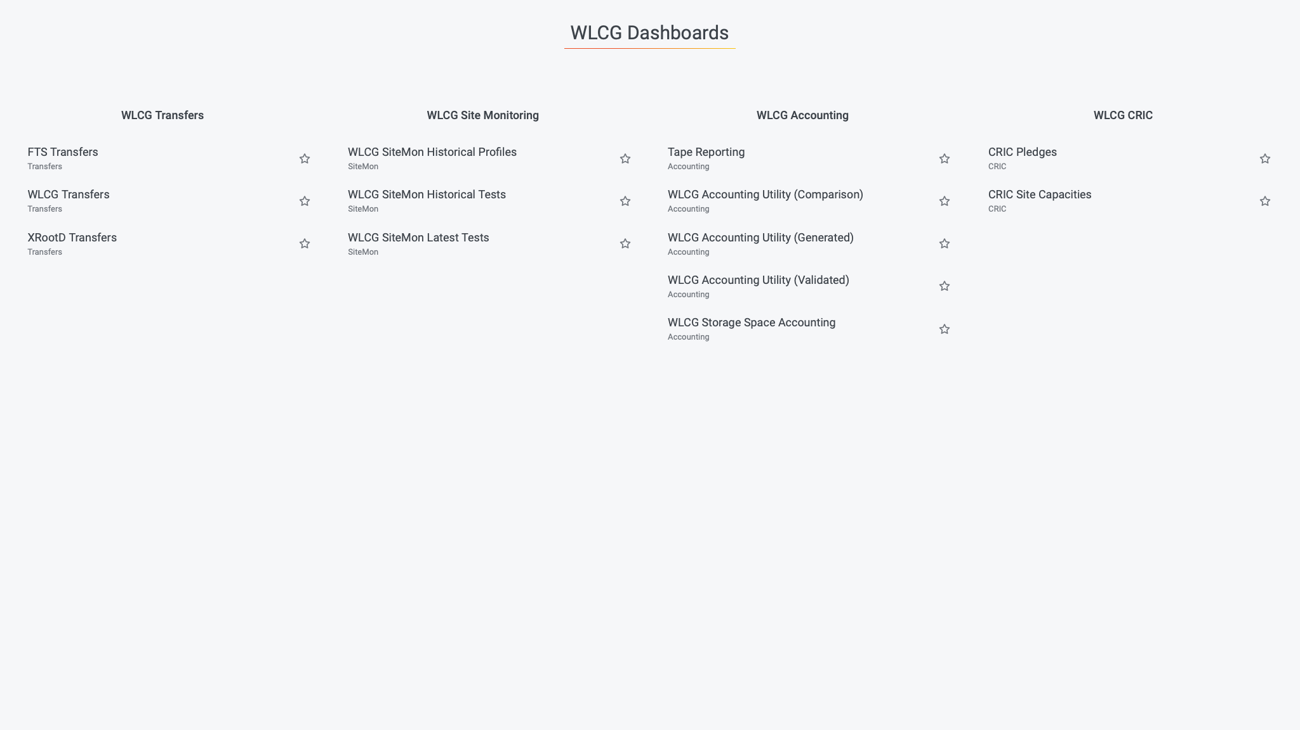
LINK

Slide 5
Experiments data in MONIT
ATLAS data
  Job Monitoring from Panda and CERN T0 databases
  DDM Transfers from Rucio events and Rucio traces
  DDM Accounting from Rucio accounting in HDFS
  K8s Rucio Prometheus metrics and logs
  Site Status Board metrics (SSB)
  Services availability metrics (SLS)
  Others: Event Index metrics, Event Service metrics

Slide 6
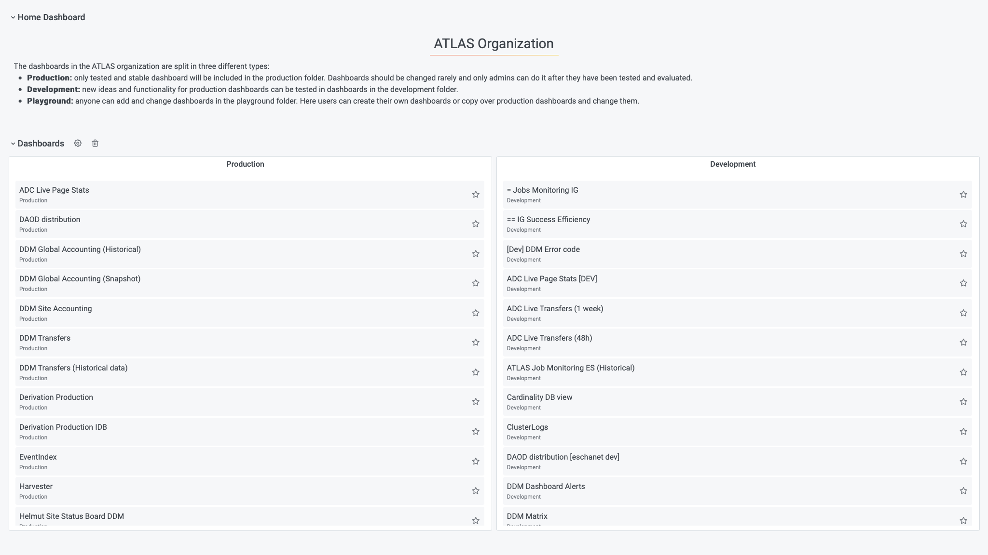
LINK

Slide 7
Experiments data in MONIT
CMS data
  Job Monitoring from Condor metrics
  Data Transfer from AAA and Rucio metrics
  Site Readiness metrics (SST)
  More metrics: TZero, WMAgent, WMArchive, etc.
  Logs: SI-Factory, CMSWeb, CMSWebk8s, Crab
  Services availability metrics (SLS)

Slide 8
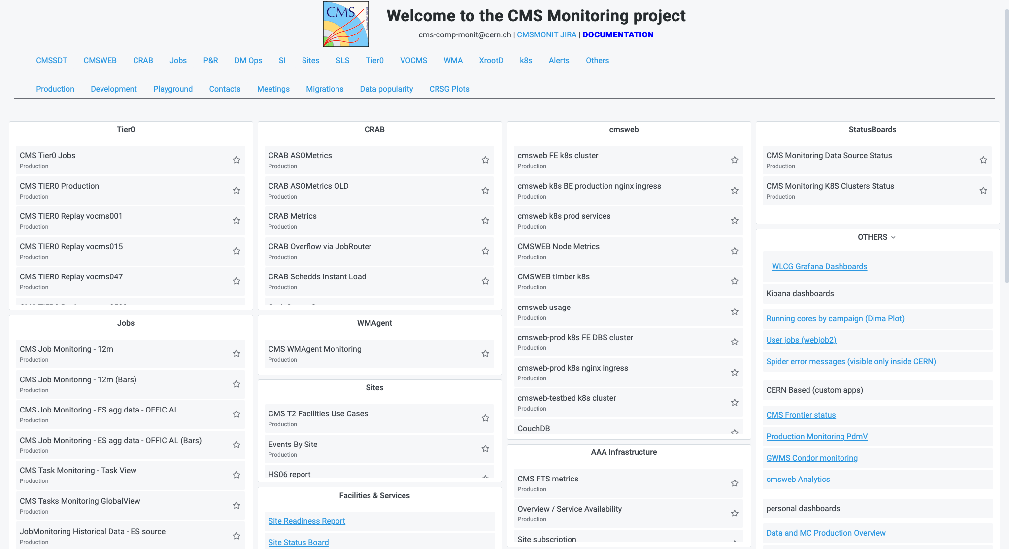
LINK

Slide 9
Other datasets in MONIT
CERN and WLCG Network
  LHCONE metrics
  LHCOPN metrics
  Perfsonar metrics
CERN Data Centre
  Host metrics and alarms (HW + OS + services)
  Services availability, KPIs, and SLIs
  Syslog data and several service logs

Slide 10
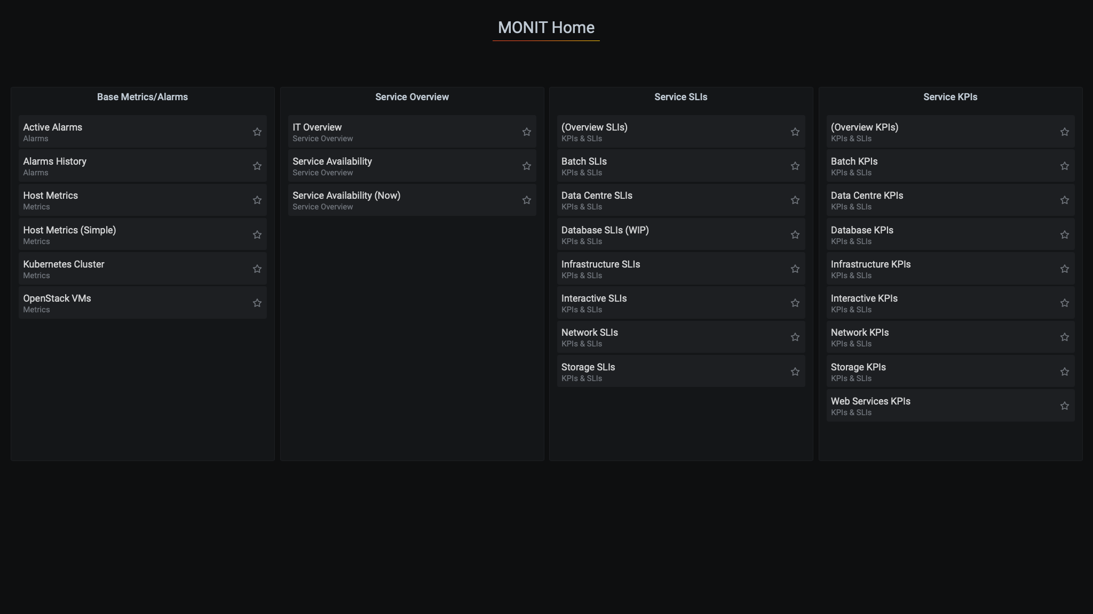
LINK

Slide 11
Using MONIT - Ingestion
You can send metrics, alarms, or logs
Several endpoints available
  You send your data via HTTP
  You use or write a Collectd plugin
  You expose Prometheus data for scrapping
  You put your data in a Messaging Broker
  (from outside CERN only AMQ is supported)
Free to choose your client
HTTP
Collectd
MONIT
Prometheus
AMQ

Slide 12
Using MONIT - Access
For plotting and dashboards
  Use Grafana UI
For data discovery
  Use Kibana UI
For programmatic access
  Use Grafana HTTP Proxy or SWAN
Kibana and SWAN are services managed by other IT teams
Grafana HTTP
Grafana UI
MONIT
Kibana UI
SWAN

Slide 13



Using MONIT - Storage
(raw data)
3 days
(raw data)
1-3 months
(agg. data)
5-10 years
(agg. data)
5-10 years
(raw data)
13 months

Slide 14
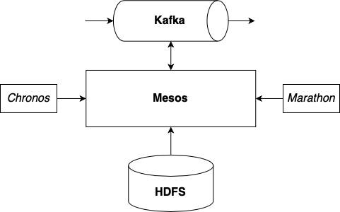
Using MONIT - Processing
Optional step mainly used for:
  Enrichment, Aggregation, ETL
Most jobs are Spark based
  Can run in streaming or batch mode
  Few Logstash jobs for simple cases
Managed by MONIT or Users
  Today MONIT runs jobs for WLCG use cases and large Experiment use cases

Slide 15
Thank you !
http://cern.ch/monit-support
http://cern.ch/monit-docs

